Slide 1

IBM Netezza Performance Server
Event Guide
Marc Coudijzer
WW Solution Marketing Lead, Data & AI https://www.linkedin.com/in/marccoudijzer

Slide 2
What’s in this event kit?
Campaign objectives
Target audience
Key product messaging, copy blocks
Event planning and execution
Event promotion
Event execution: 30, 60, 90-day timeline
Additional resources

Slide 3
Event overview
The objective of this campaign is to get the audience to:
Discover
Learn
Try
Buy
Discover means introducing your audience to your solution.
Learn means you’re providing deeper information, so your audience connects their needs with the benefits of your solution.
It’s way too easy to drown in data. Yes, your business generates and collects valuable information that can give you an edge over the competition, but wading through the data deluge - making sense of it all - takes time and money and often comes with security risks and delays. What’s needed is a straight-forward way of efficiently storing and operationalizing your data, a process that results in faster querying, elastic scaling, and real-time analytics that can inform decisions immediately.
Execute this event as we explore how the next generation of IBM Netezza Performance Server enables organizations to unify their analytical data, powering real-time decision making, data governance and security, and analytics accessible to everyone across cloud, hybrid, and on-premises deployments. You will learn how Netezza helps you predict data warehousing costs based on performance needs, securely collaborate across your organization, automate maintenance and operations, and power analytics at any scale.
Try means you are giving your audience the opportunity to experience the advantages of your solution.
Buy means you are providing the mechanisms to purchase or engage with your solution; enabling the transaction, including pricing information, sales incentives or discounts.

Slide 4
Product overview
This product or solution does…
With IBM Netezza Performance Server, we make analytics accessible across your organization, with a governed, trustworthy and secure source for your data designed to unify your analytical data in the cloud, hybrid, and on-premises.
Netezza's cloud-native architecture built on decades of innovation helps you securely collaborate across your organization, automate maintenance and operations, predict data warehousing costs based on performance needs, and power analytics at any scale
Helping clients to…
Scale on-demand: With Netezza in the cloud, customers only pay for the resources they need. It’s as easy as deciding how fast you want to go and how much data you need, when you need to.
Collaborate across secure and governed data: Built on IBM's decades of expertise in data governance and security, safely collaborate across your organization with built-in data visibility, auditability, data masking, access controls, and more.
Make decisions faster: With built-in analytics, ML, and data lake integration, run complex queries in an optimized way for quick execution times – improving time-to-insight and decision speed from days to minutes.
Run highly resilient analytics: Ensure reliability of your data with a highly available and fault-tolerant Netezza deployment, ensuring your data warehouse can run 24x7x365.
Automate maintenance and operations: Run Netezza as a fully managed service, which means no armies of administrators are required, helping teams stay focused on other important tasks

Slide 5
IBM Netezza PerformanceServer
Target buyers and pain points
    Audience
Primary Audience: CDO, CIO, VP of Analytics Secondary Audience: COO, CFO, LOB across Data Analytics, Data Science, Engineering, and Enterprise Architecture
They are tasked with…
Helping lead the digital transformation efforts to increase operational efficiency, enhance the customer experience, and deliver innovation by monetizing their data to create new revenue streams.
But are challenged by…
Disconnected processes and siloed data; Lack of reliable, timely, and quality data; data deluge – difficulty making sense of it all
Managing complexity and disruptions from rapidly evolving business needs and technology choices – data management being a moving target with both legacy and modern technologies
Too slow to help business innovate and compete effectively with data, AI and application assets while optimizing cloud/infrastructure use
Unprepared to meet enterprise scaling, latency and security/governance requirements to transitioning from experimentation into full production

Slide 6
IBM Netezza Performance Server
USE CASE #1
Unified analytics for everyone
USE CASE #2
Cost-predictability in the cloud
USE CASE #3
Simple, high-speed analytics
USE CASE #4
Accelerate data science and machine learning
SALES PLAY OVERVIEW
Unified analytics for everyone-
Query and analyze different data types and workloads, without the risk of moving your data.
Built-in data visibility, auditability, data masking, access controls, and more.
Spot patterns and trends and perform investigative tasks on years of data
Control cost and price-performance of your data warehouse
Ultimate control with independent scale of compute and storage and granular elastic scaling
Lower total cost of ownership with no overcharges or over provisioned t-shirt sizes
Hourly-credit consumption model
Simple, high-speed analytics
Eliminate the need to deal with the additional overhead associated with data pre-processing and transformations for faster insights
Combined with patented massively parallel processing, achieve faster insight and faster time to value with vastly superior price-performance.
Rich built-in analytics and geospatial capabilities perfected over decades, Netezza brings analytics to your data and enterprise reporting
Accelerate data science and ML
High speed and scalable machine learning processing for Python and SQL without moving your data
Reduced security and compliance risks with one platform for all of your analytics and ML
Connect to your ML tool of choice and provide model results for your teams and applications to easily consume and act on ML-driven insights
Make analytics accessible across your organization, with a governed, trustworthy and secure source for your data designed to unify your analytical data in the cloud, hybrid, and on-premises
PRIMARY AUDIENCE
CDO, CIO, VP of Analytics
PRIMARY AUDIENCE
COO, CFO, LOB
DIFFERENTIATORS
-Up to 47% lower TCO than competition
-Up to 78% faster performance than competition
-Decades of expertise in data governance and security of your warehouse
-Granular elastic scaling in the cloud – no "t-shirt" sizes or overprovisioning
- Risk free upgrades with a single command
COMPETITORS
Snowflake, Microsoft Synapse, AWS Redshift, Google BigQuery, Teradata, Yellowbrick (primarily LATAM)

Slide 7
Plan your event
Step 1
Choose the date and time and start planning 4-6 weeks in advance.
Customize the event name to make it specific to your company and find speakers to cover the topic.
Step 2
Review the the client presentation included in this kit to help you lead
the event.
View the IBM Netezza Performance Server Event Kit on My Digital Marketing for additional assets.
Step 3
Engage your distributor (VAD) and regional IBM Channel Sales Reps to help you plan the event.
Step 4
Decide on your target audience and create your invitation list.

Slide 8
Plan your event
Step 5
Ensure there is a compelling reason to attend your event.
Be sure to include the benefits of attending the webcast in your registration page and email series.
Step 6
Use co-marketing funds if appropriate. These funds can be used to help promote the event to drive better attendance.

Slide 9
Execute your event
Step 1
Create an online meeting using your platform of choice (e.g., WebEx,
Zoom, ON24 etc.), or book the facilities for a physical event.
Step 2
Customize the event agenda to be specific to the value your company adds to the topic.
Use that custom messaging in the registration page, email series, and other promotions.
Step 3
Activate registration in
My Digital Marketing. Customize the following:
Meeting name
Date and time
Speakers and agenda
Your online meeting link
Step 4
Promote the event.
Create excitement by including key webinar ideas and speakers.
Start a social conversation about the event using company-specific hashtags and registration URL.

Slide 10
Execute your event
Step 5
Activate the email series
to connect with known clients/contacts. These templates are available in the kit.
Step 6
Contact your attendees within 48 hours following the meeting for next steps.

Slide 11
Overview of event kit
Registration
Company-specific registration page
Confirmation page
Confirmation email
Email series
Invitation to webinar
Reminder to register
Reminder to attend
Post-event follow-up
Social posts
Series of 3 posts to promote events
Use your unique URL for the registration page to drive attendance
Additional resources
Client presentation
for webinar

Slide 12
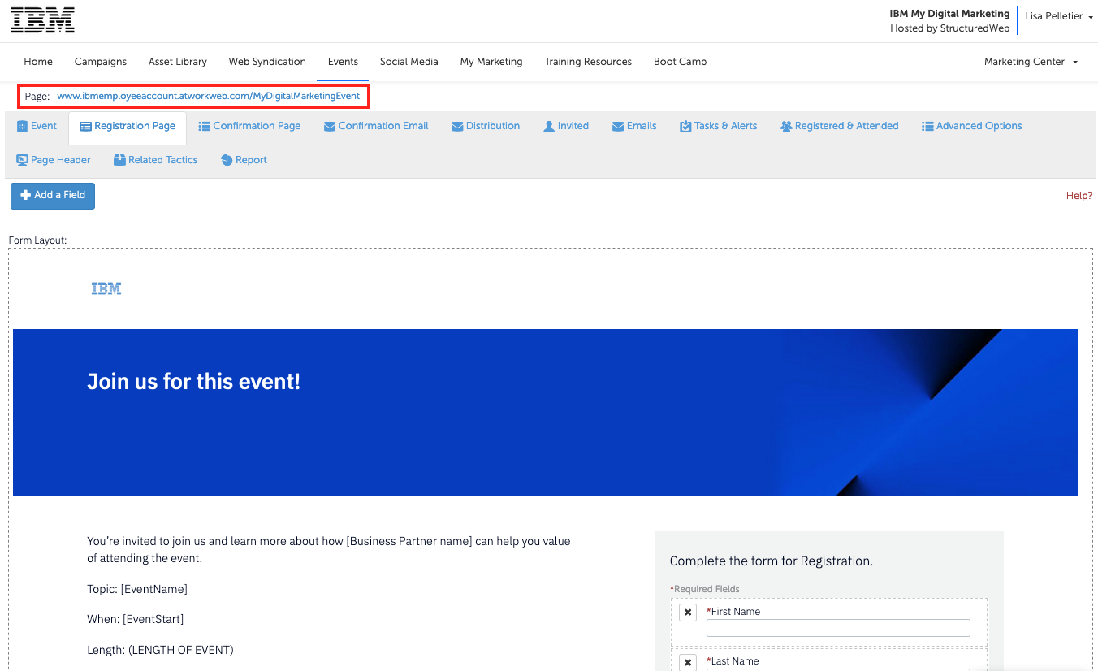
Promote your event
Ideas for driving traffic to registrations:
Social posts, organic
or paid
LinkedIn article
Blog post
Website home page
You can find the URL for your registration page at the top of the Registration tab within the activated event.
(Your URL will be unique to the event and your company name).
Each event activated in My Digital Marketing
comes with a personalized registration page with
a company-specific URL.
In addition to using the email invitations supplied in this kit, you can also drive attendance directly to the registration page by using your custom URL.

Slide 13
Event flow
Visit
Events tab in My Digital Marketing to browse events
Select an event
Activate
Company-specific webinar registration page in My Digital Marketing
Promote
Send invitations, promote
with social media, blogs, website, Additional assets
are available to help host
and promote the event.
Registration
Leads go directly to the
Business Partner account
in My Digital Marketing.
Progress
Confidential leads from the event.

Slide 14
Key tasks to complete in the next 60 days
30 days
60 days
Plan
Register and set-up My Digital Marketing
Connect with IBM or VAD
Design campaign journey and goals
Build event calendar
Allocate budget/Co-marketing
Execute
Activate event registration page
Customize email and social messaging
Post to social channels, blog, website
Launch email invitation series campaign
Post event follow up email
Measure
Sales lead progression
Review results/ROI

Slide 15

Enablement assets
Sales education
Hammerhead Enablement Recording
Netezza Mako EOS Sales Enablement
Netezza Mako EOS Sales Enablement Recording
Tri-Dimensional Analysis CTP Tactical Enablement
Link for CTP's of Netezza - Box folder (request access through Duncan Martinson (dscottmartinson@ibm.com)
SQL on Parquet Preview: Using Netezza Performance Server On Cloud as a Data Lakehouse
Presentations
Client Presentation
Customer facing assets
Netezza for Cloud Pak for Data Solution Brief
Netezza on-prem Infografic
Netezza aaS Infografic
Netezza SaaS Client Webinar (with demo)
Competitive One Pager on-prem and aaS
Expert Labs Upgrade Services from Mako to Cloud Pak for Data Systems with NPS & Netezza SaaS
Netezza for CP4D YouTube client facing video

Slide 16
IBM sign-off

